Slide 1
Forescout eyeExtend Connect
Google Mobile Device Management (Google MDM)
Dan Kimball / January 1, 2020

Slide 2
Google MDM – Chromebook Use Cases (Phase I)
Chromebook Compliance
Boot Compliance – Validate boot verification of Chromebook endpoint to ensure integrity
OS/Platform Compliance – Validate the platform is an official OS version
User Compliance – Validate that user logged into the Chromebook is the owner of record.
Chromebook Management
Synchronization Verification – Ensure the synchronization between the device and the cloud
Asset Management – Update asset ID, location and organization information
Provision Management – Manage the provisioning/deprovisioning of Chromebooks
Chromebook Control
Network Access – Provide network access control on the network based on Chromebook attributes
Security Control – Enable/Disable the Chromebook and change groups and/or organization membership to drive endpoint security controls

Slide 3
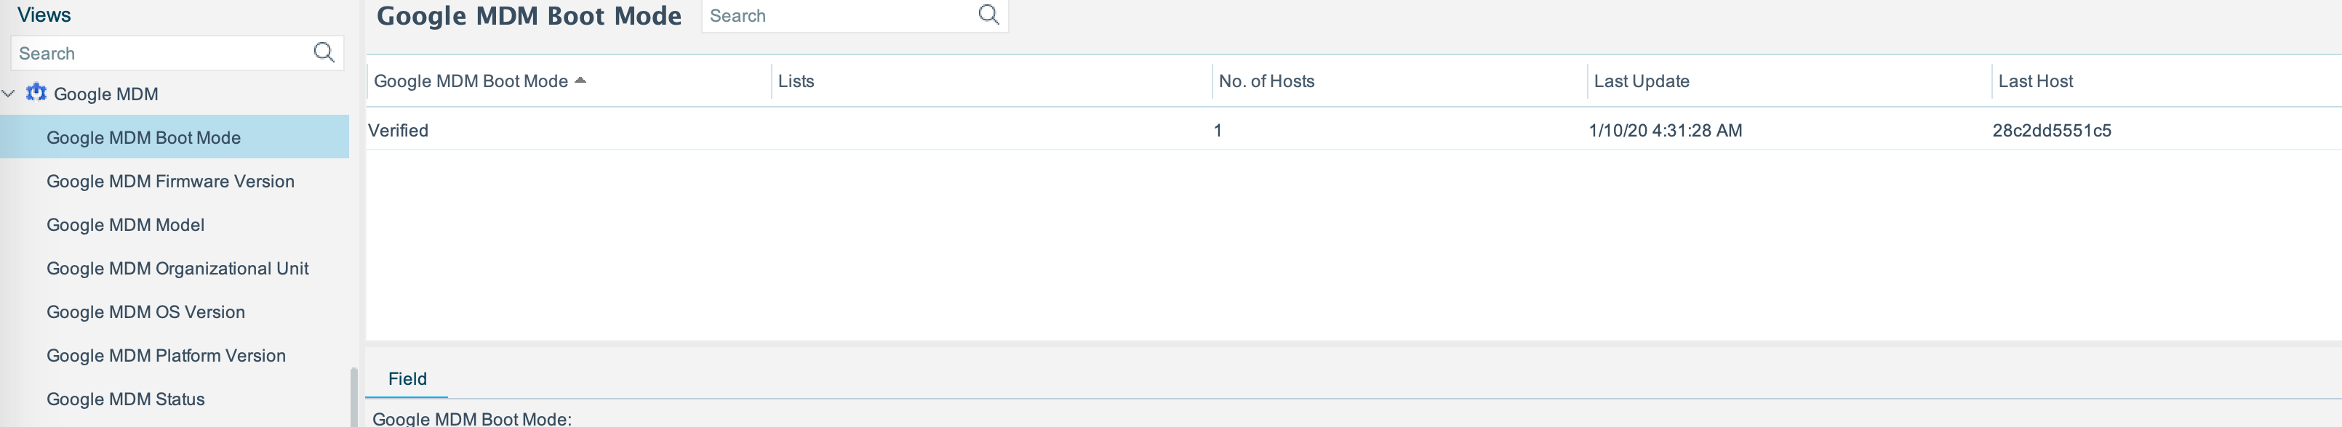
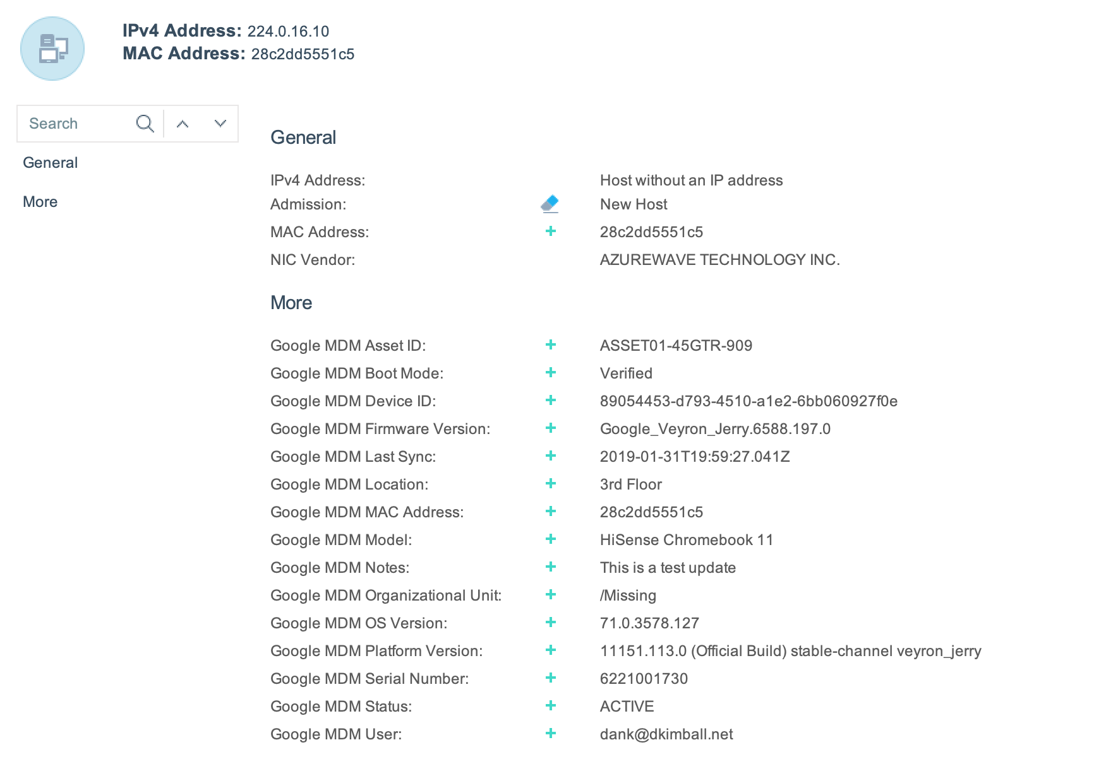
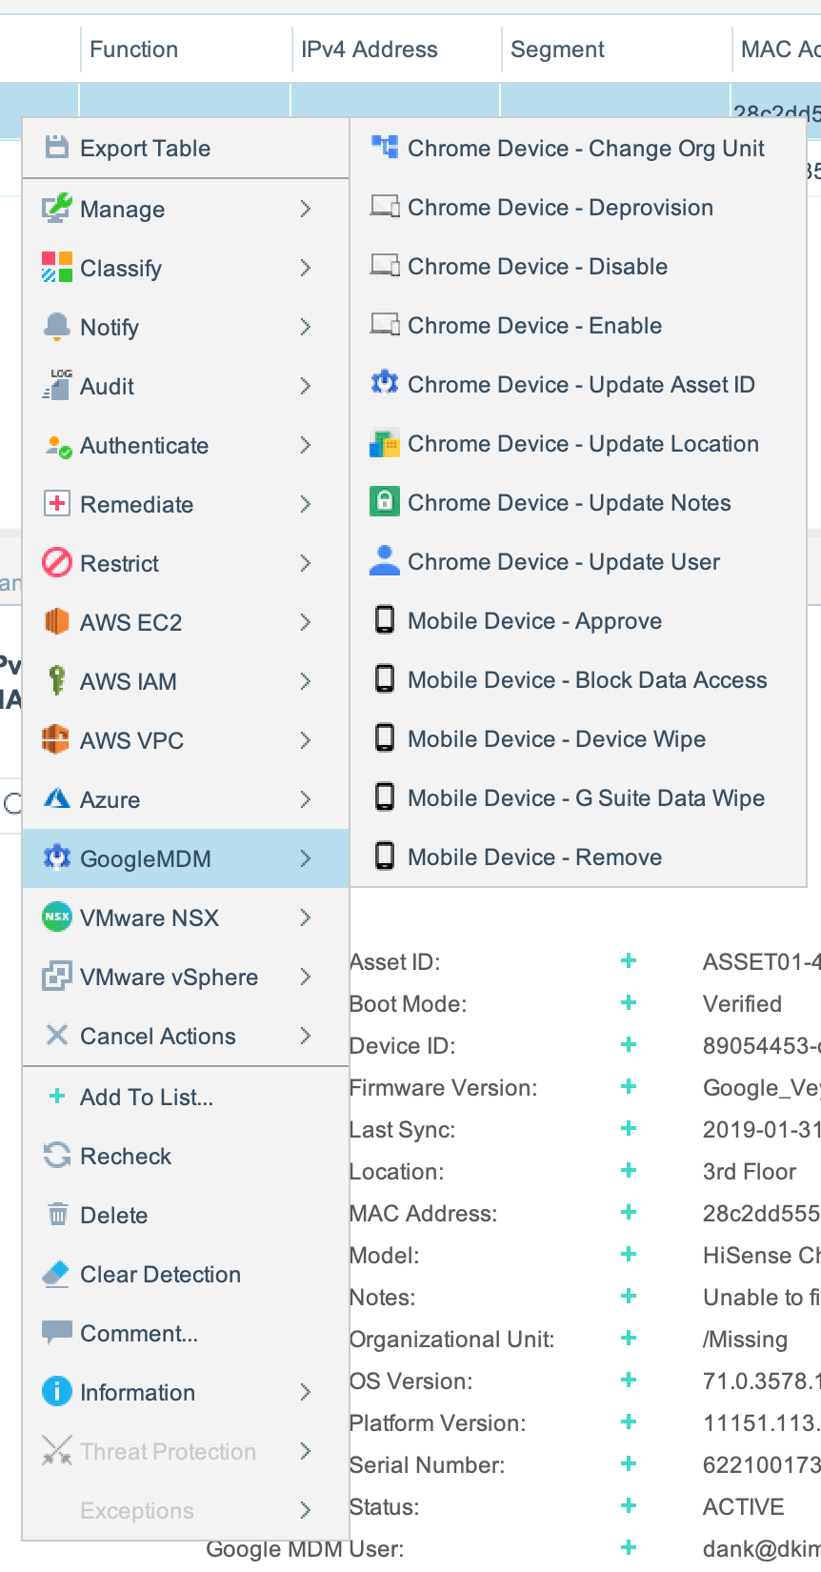
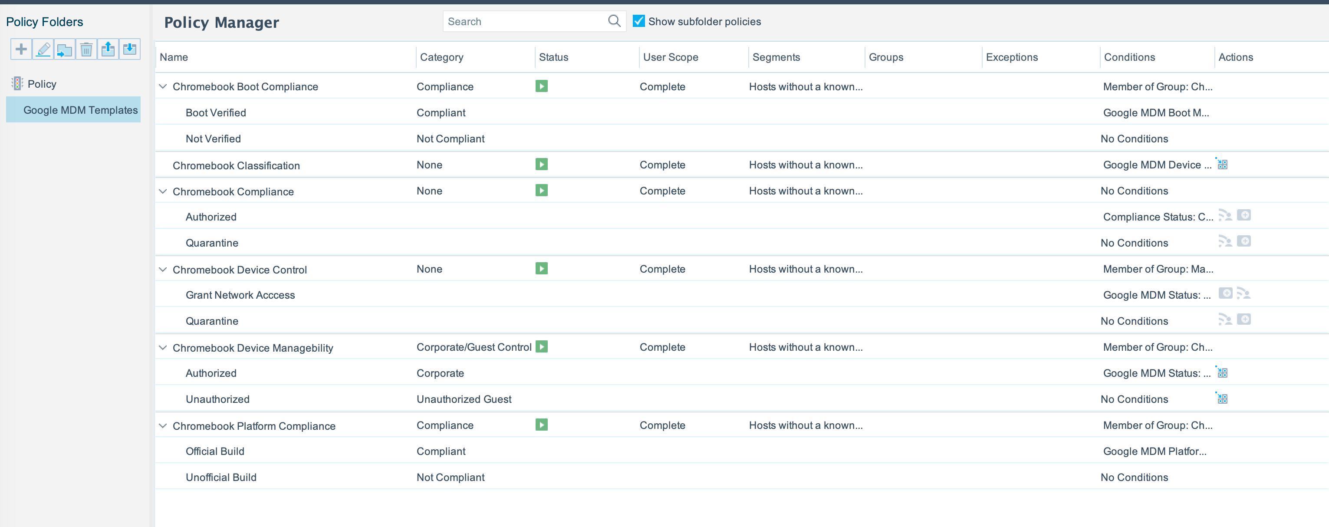
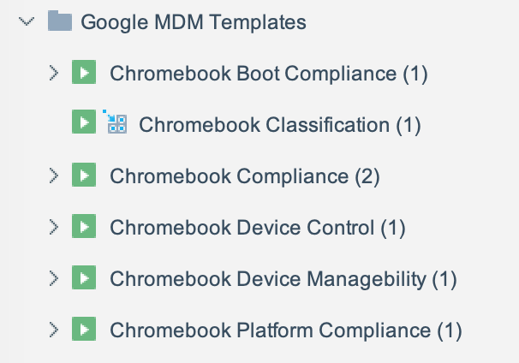
Google MDM – Screen Shots

Slide 4
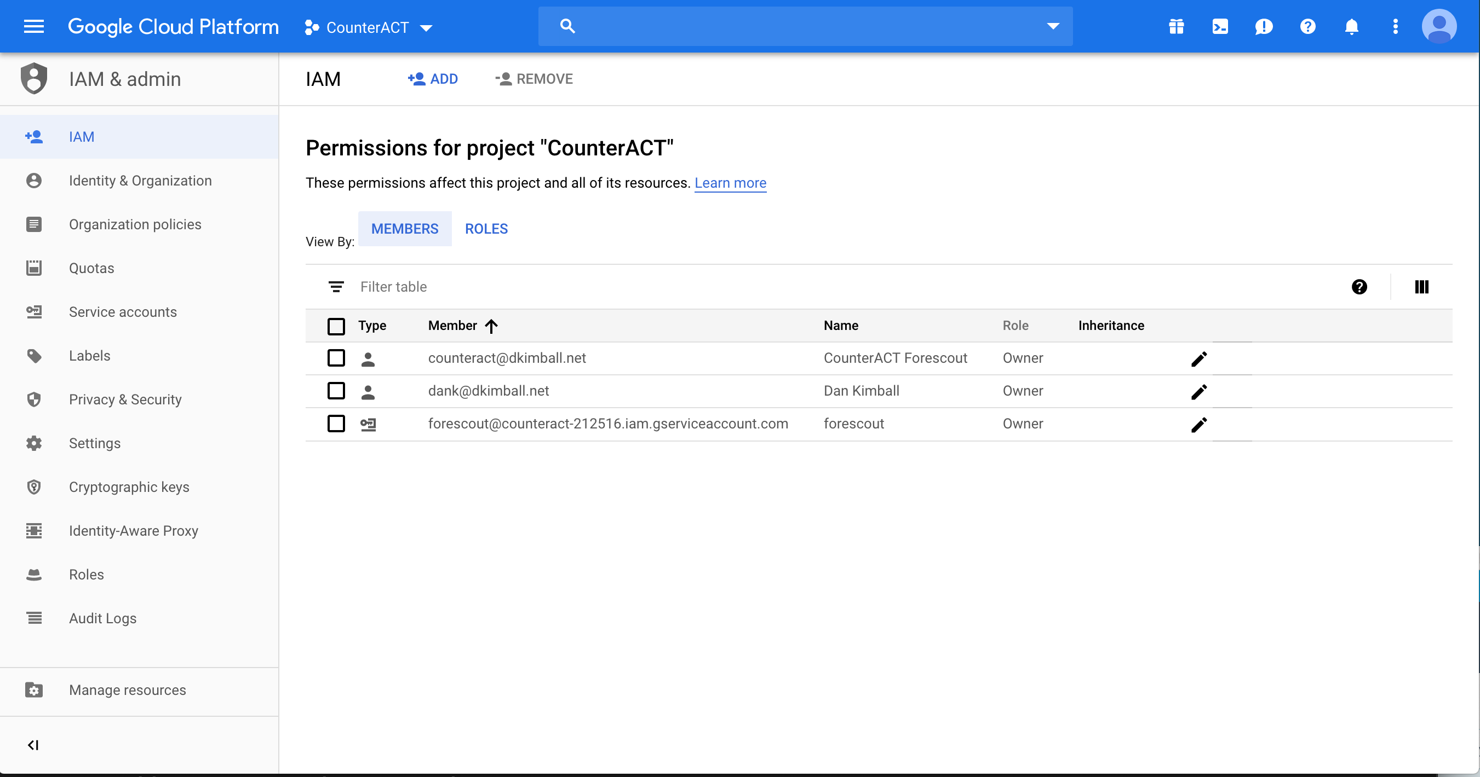
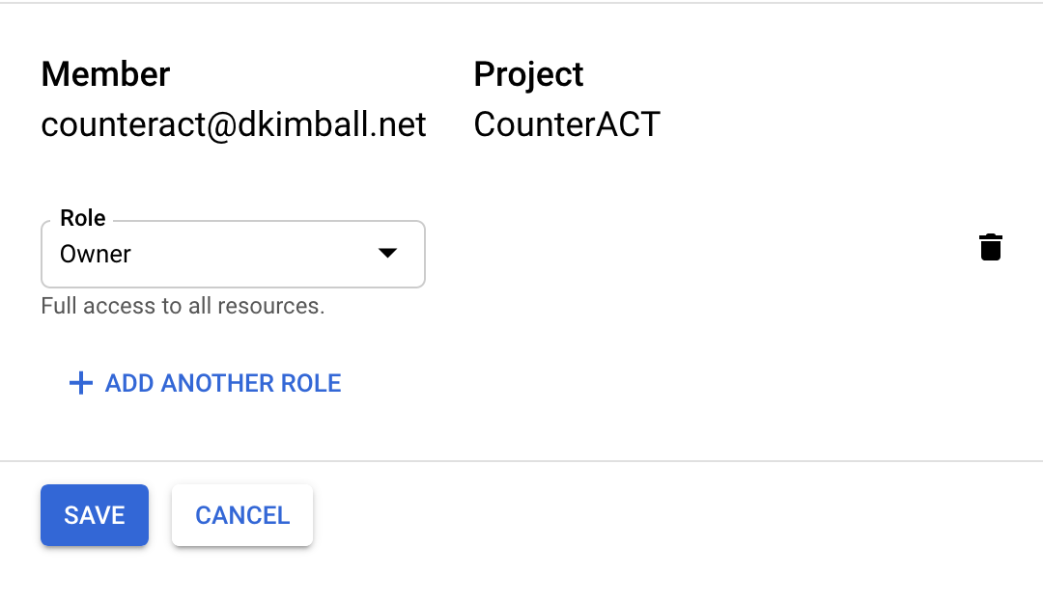
Google MDM – Account Setup
Goto console.cloud.google.com
Ensure there is a project to relate the accounts to
Choose the project
Create an account that has a role with sufficient privileges. This was originally setup with an account that was set to owner

Slide 5
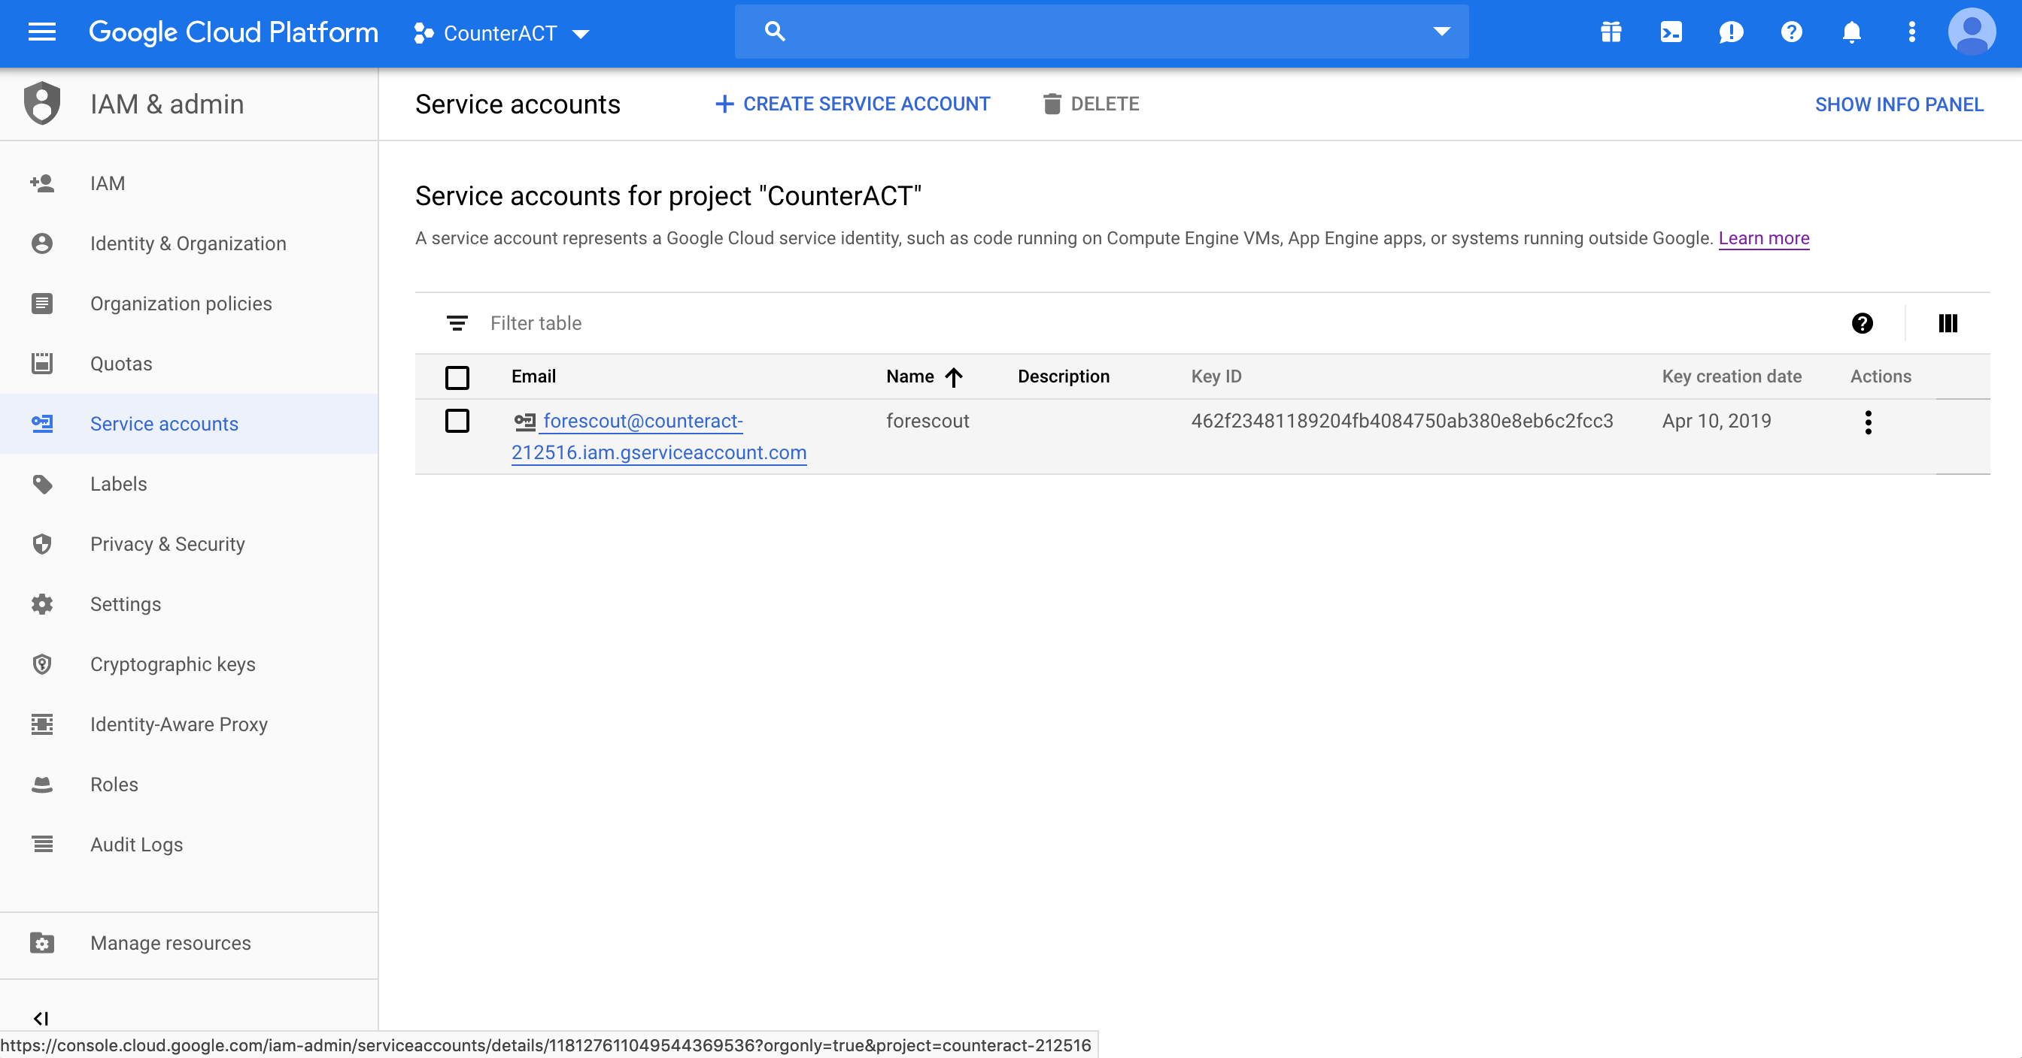
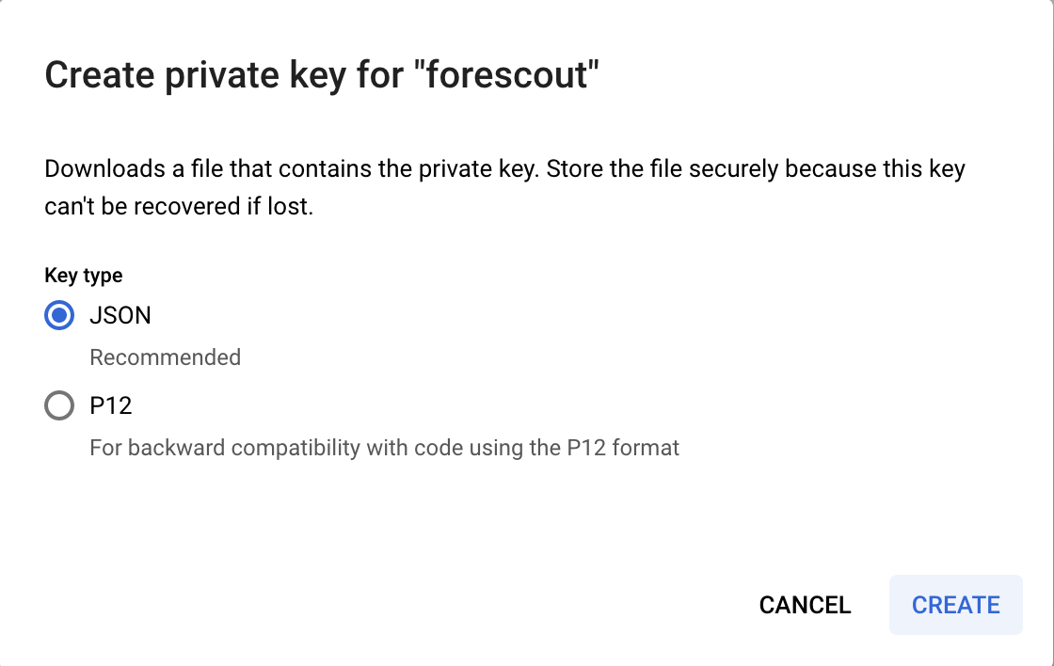
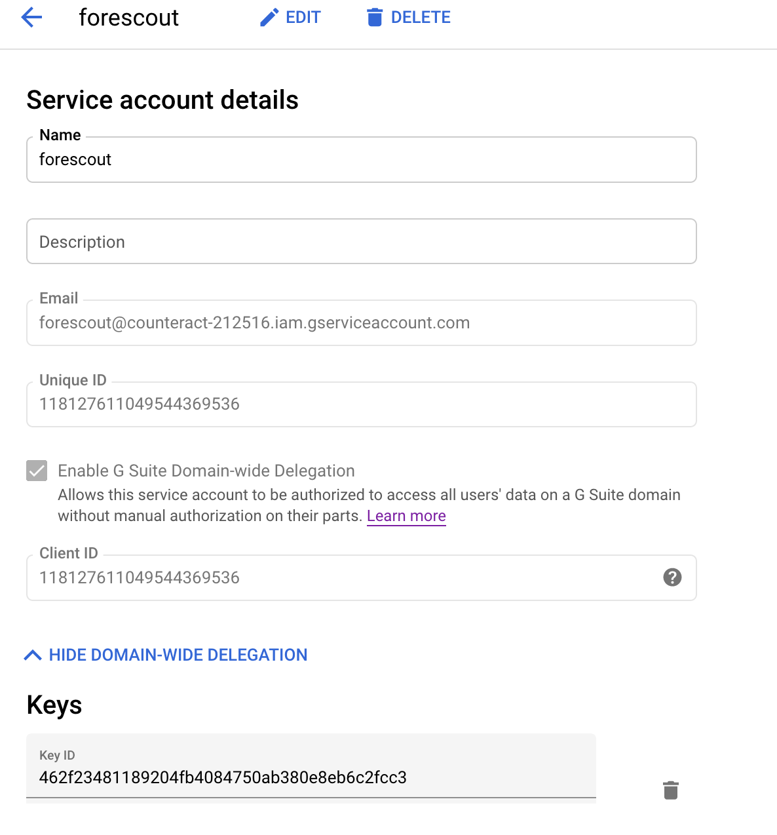
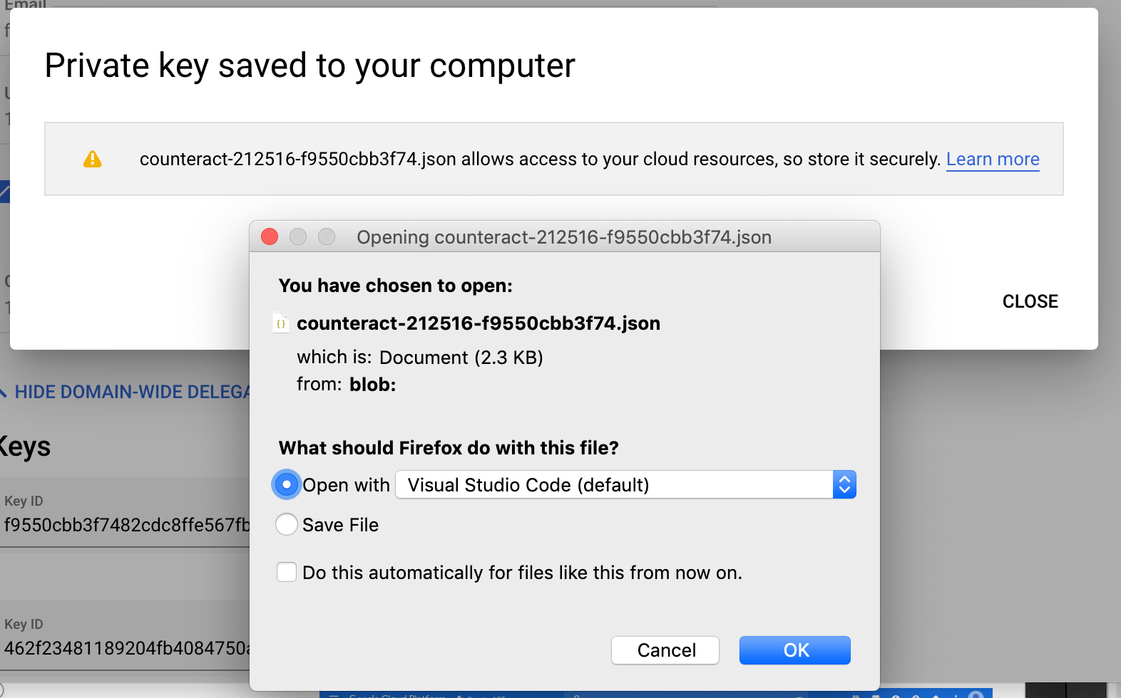
Google MDM – Account Setup
Go to the service account selection and create a service account
Select ‘Enable G Suite Domain-wide Delegration’
Create a key with a key type of ‘JSON’
This will prompt to download a file. This file has information we will need to use to finish setup as well as execute calls to exchange a key for a token

Slide 6
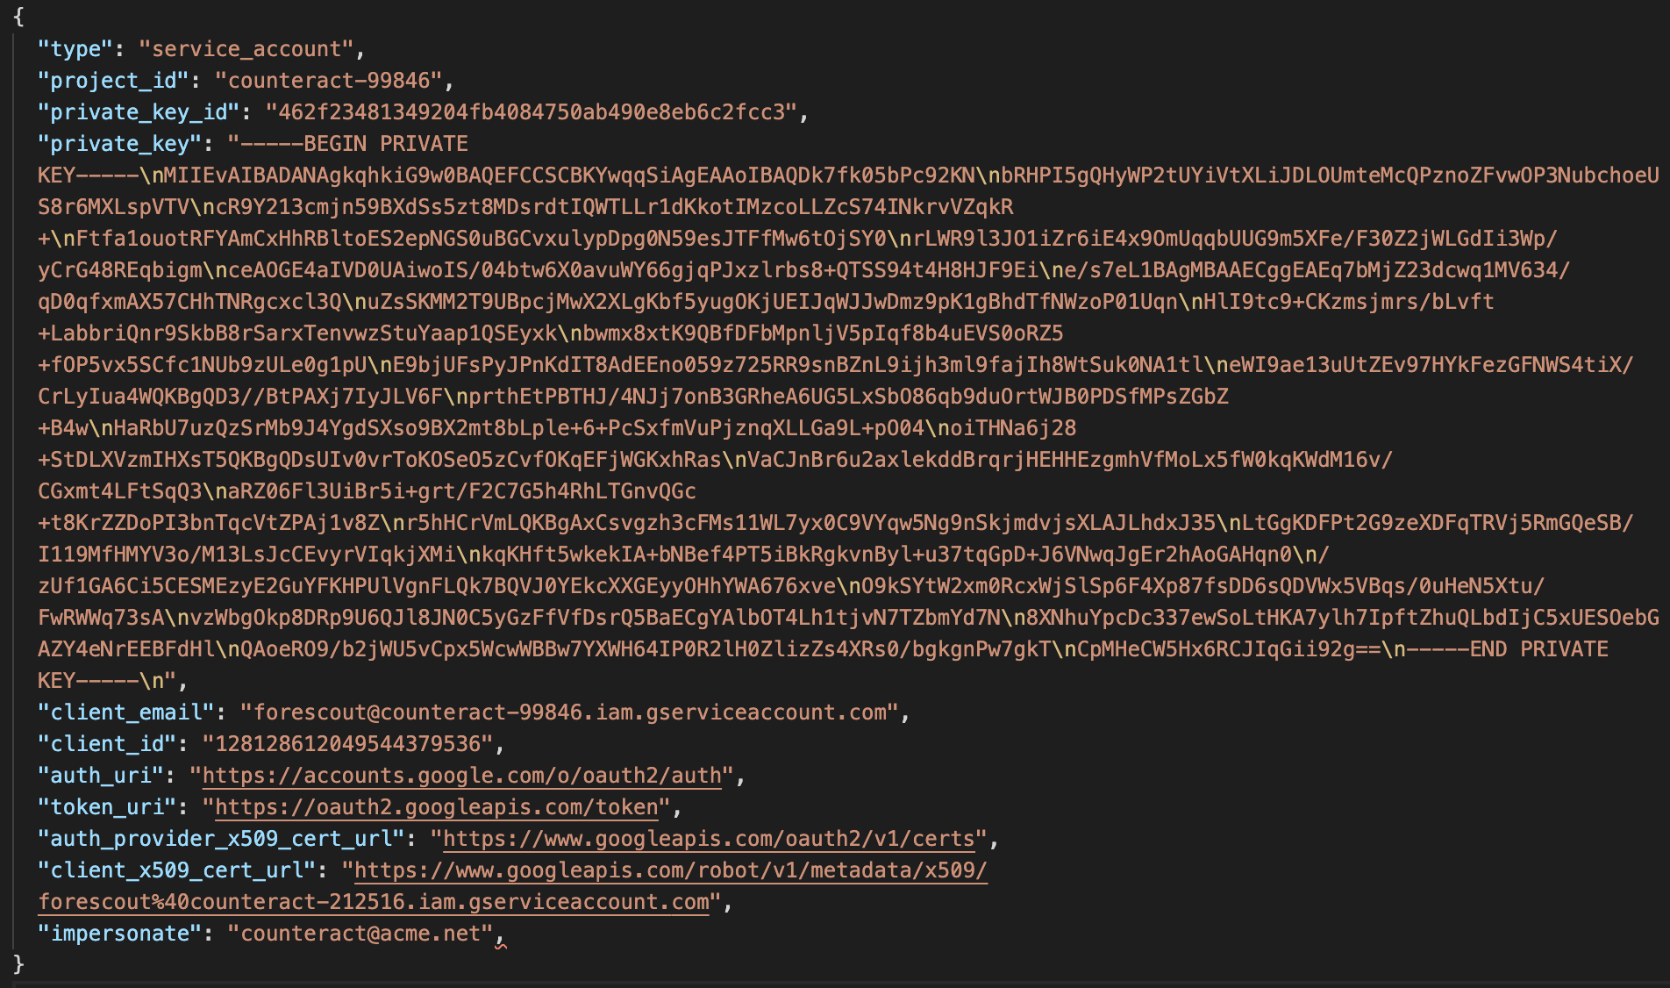
Google MDM – Account Setup
Open the JSON file that was downloaded
Several fields in the file will be used in the configuration of the Google MDM App in the eyeExtend Connect module
Information Required
Client ID
Client Email (Service Account)
Private Key ID
Private Key
Impersonate (User Account)

Slide 7
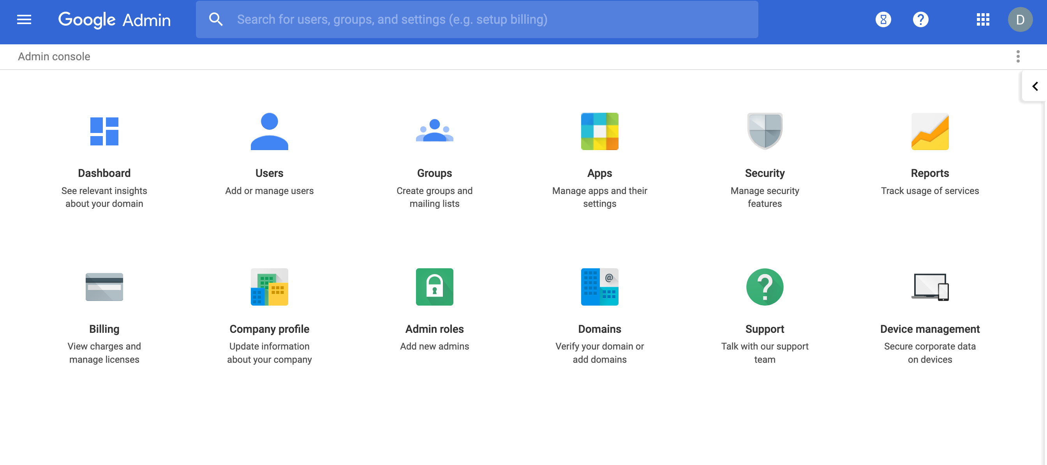
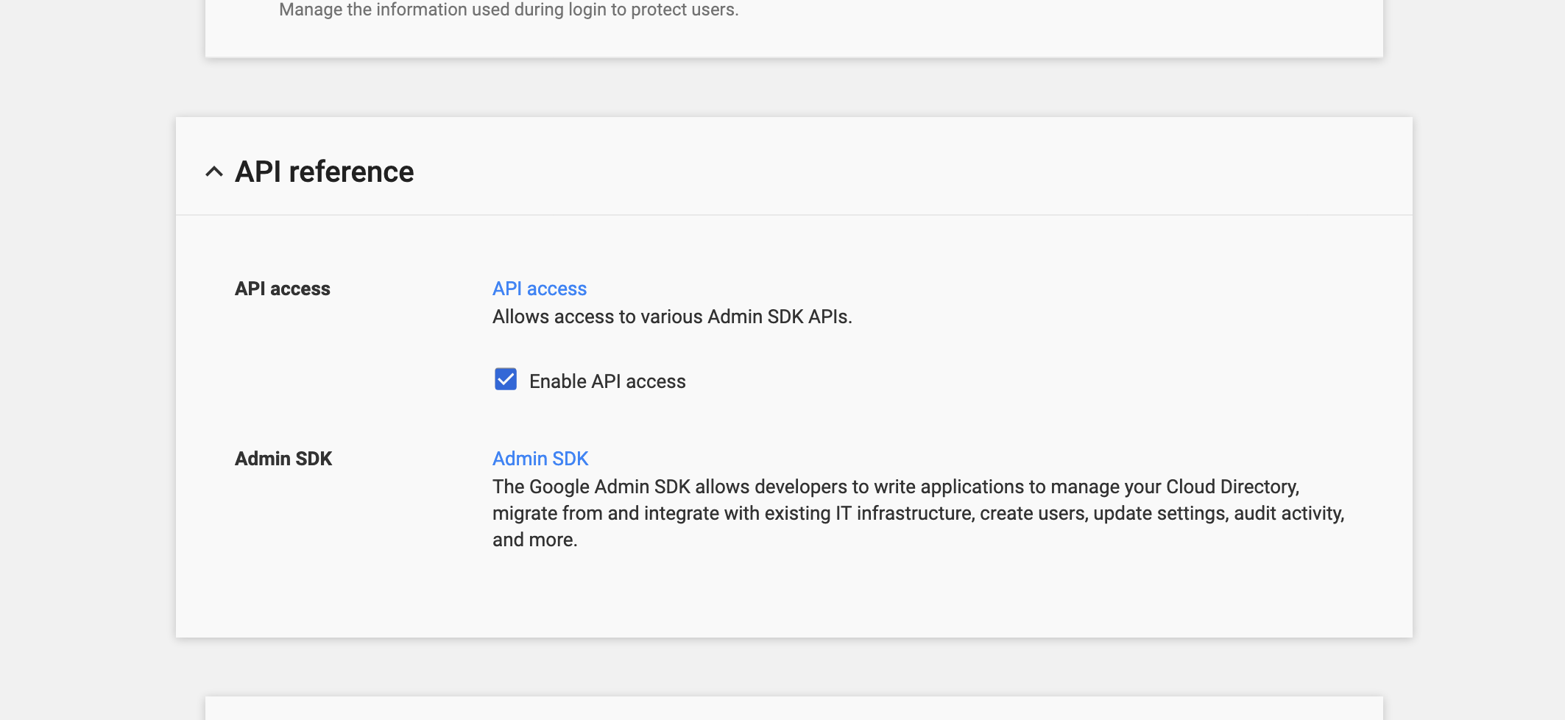
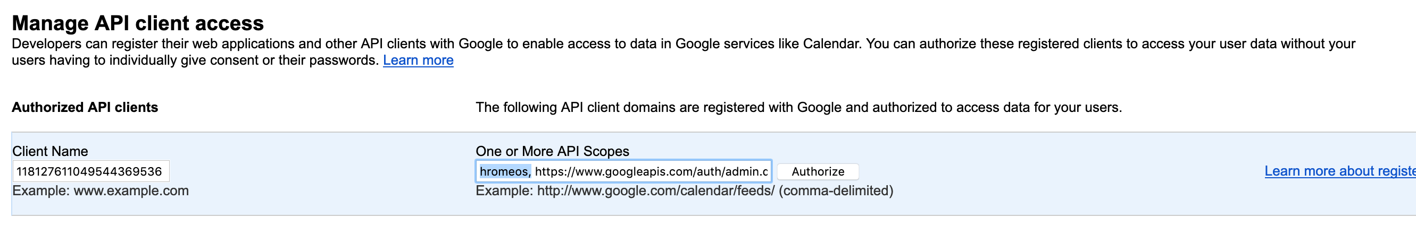
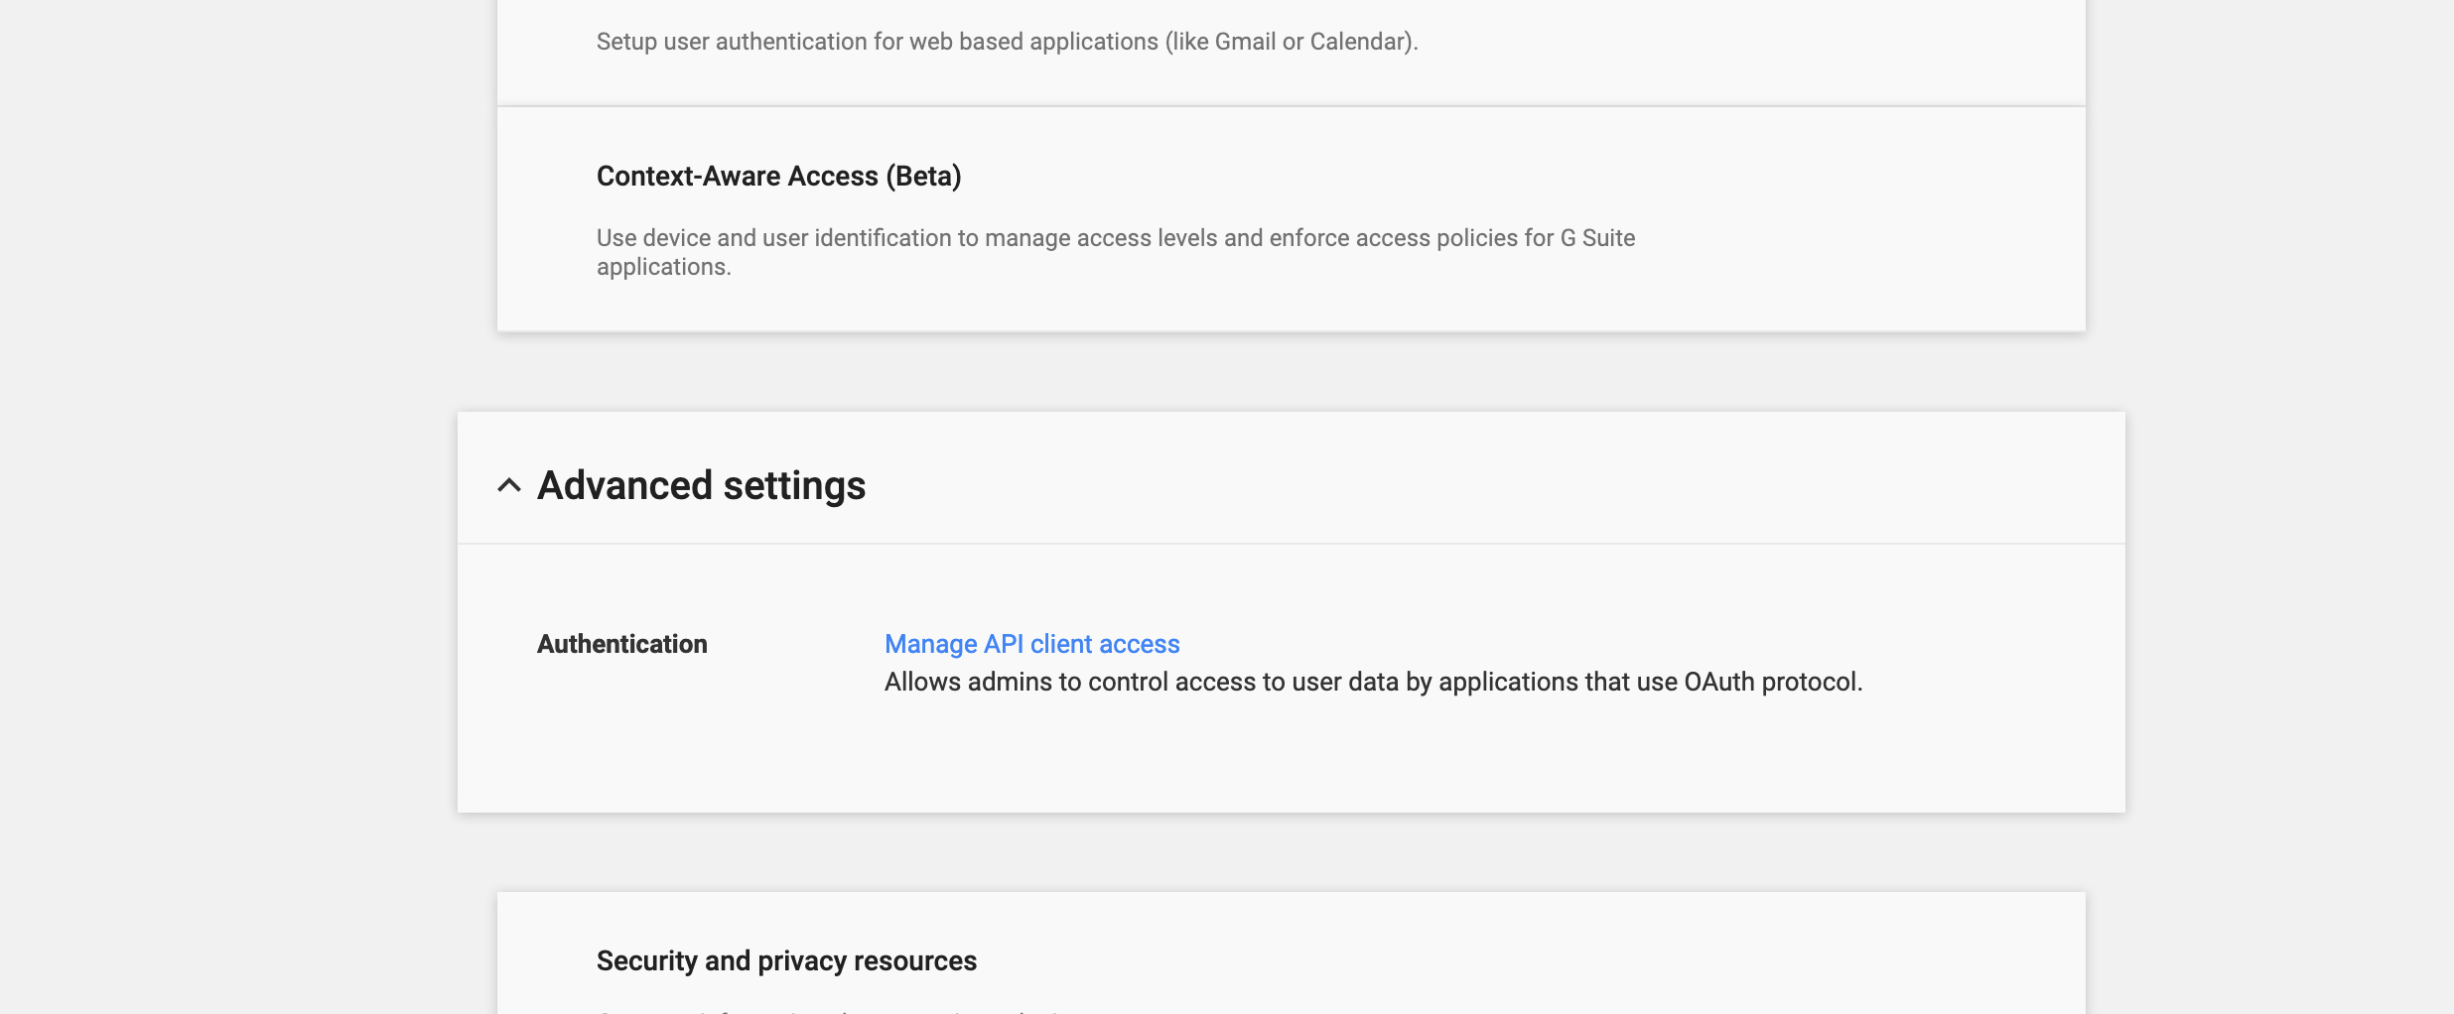
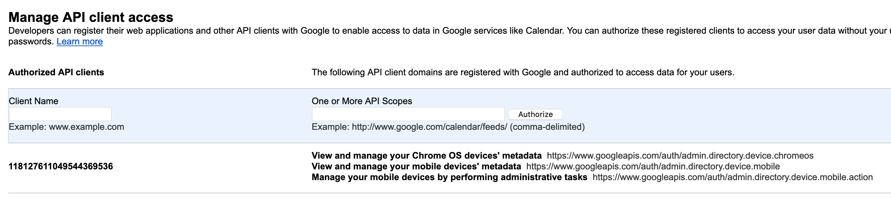
Google MDM – Account Setup
Go to admin.google.com
Choose Security
Enable API Access
Select Advanced Settings then Manage API Client access
Enter the Client ID
Fill in three API Scopes separated by commas
https://www.googleapis.com/auth/admin.directory.device.chromeos
https://www.googleapis.com/auth/admin.directory.device.mobile
https://www.googleapis.com/auth/admin.directory.device.mobile.action
Hit the authorize button and the value will appear in the list

Slide 8
THANK YOU

